Slide 1

STORE SALES – TIME SERIES FORECASTING
Colin Tran
Notes:
Hi everyone, my name is Colin Tran.
Today I will present the store sales-time series forecasting which is my final project

Slide 2

AGENDA
Project Summary
Exploratory Data Analysis(EDA)
Times Series Forecasting
Sales Prediction Using XGBOOST Supervised Learning
Notes:
For the today presentation
First, I would like to mention the project summary
Next, is the Exploratory Data Analysis
After that, I will present about the time series forecasting
And finally, I will talk about sales prediction using XGBOOST

Slide 3

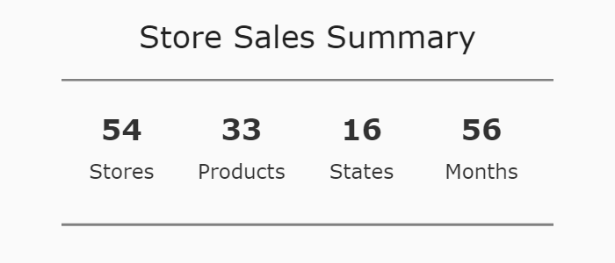
PROJECT SUMARY
Notes:
In summary, the dataset is about the sales of 54 different stores in Ecuador with 33 different product family in 16 states in 56 months which are from 2013-2017

Slide 4
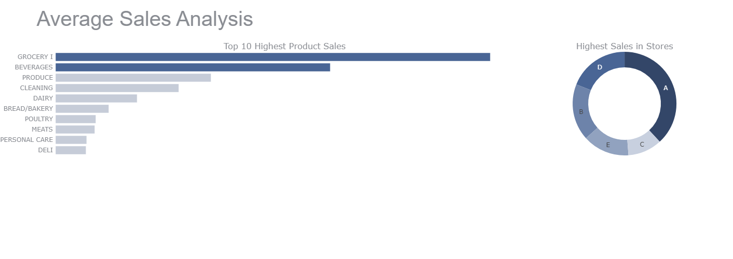
EDA
Highest sales are made by grocery and beverage products and store A has the highest sales which is 38%
Notes:
As we can see from the graph above, the highest sales are made by grocery and beverage products and store A has the highest sales which is 38%

Slide 5
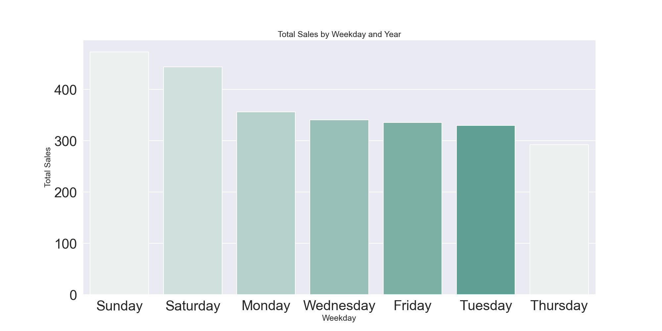
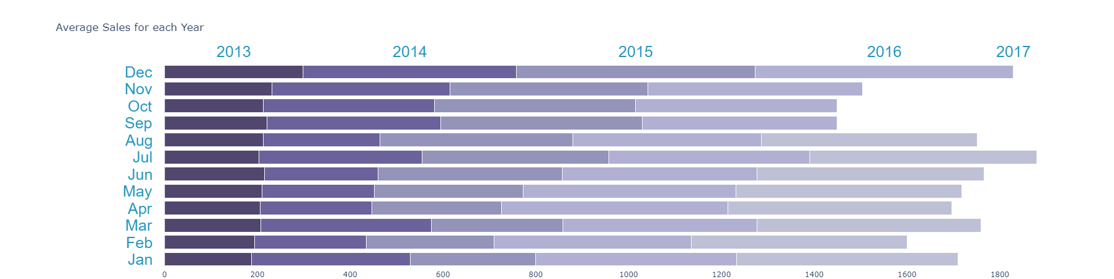
Sales are increasing gradually from 2013 – 2017. Highest sales are made in December and then decrease in January.

Slide 6
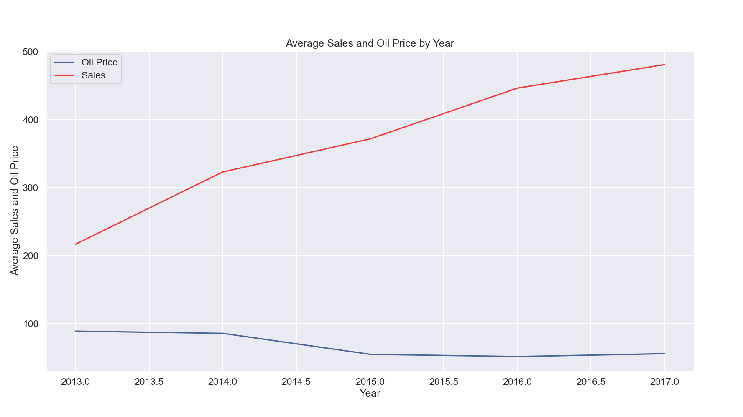
There is a negative correlation between oil price and sales. Pearson correlation coefficient(r) values: -0.058
Notes:
Ecuador is an oil-dependent country and it's economical health is highly vulnerable to shocks in oil prices. Furthermore, we can see that there is a negative correlation between oil price and store sales which When oil price changes, the sales changes in the opposite direction.

Slide 7
Time Series Forecasting
Stationary Check
Decomposition
Validate Forecast
Forecasting

Slide 8
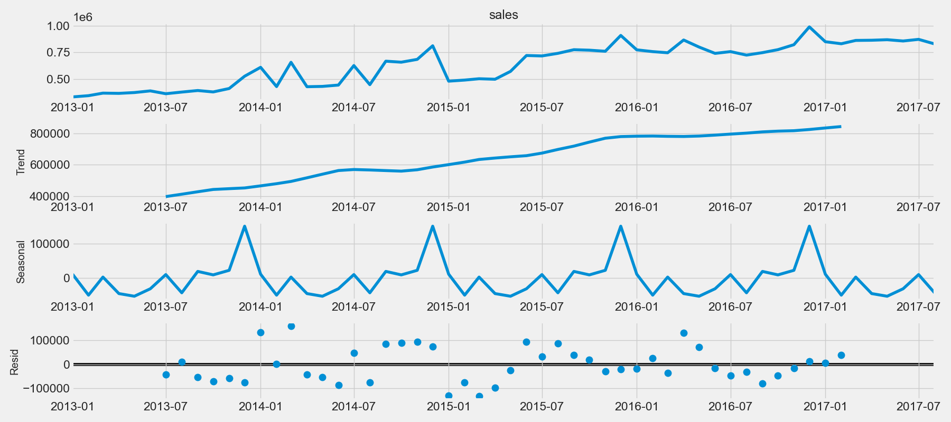
Decomposition
Notes:
Patterns appear when we decompose the series and plot the data. The time-series has seasonality pattern, peaking right before year end. Sales had been trending upward throughout the year.

Slide 9
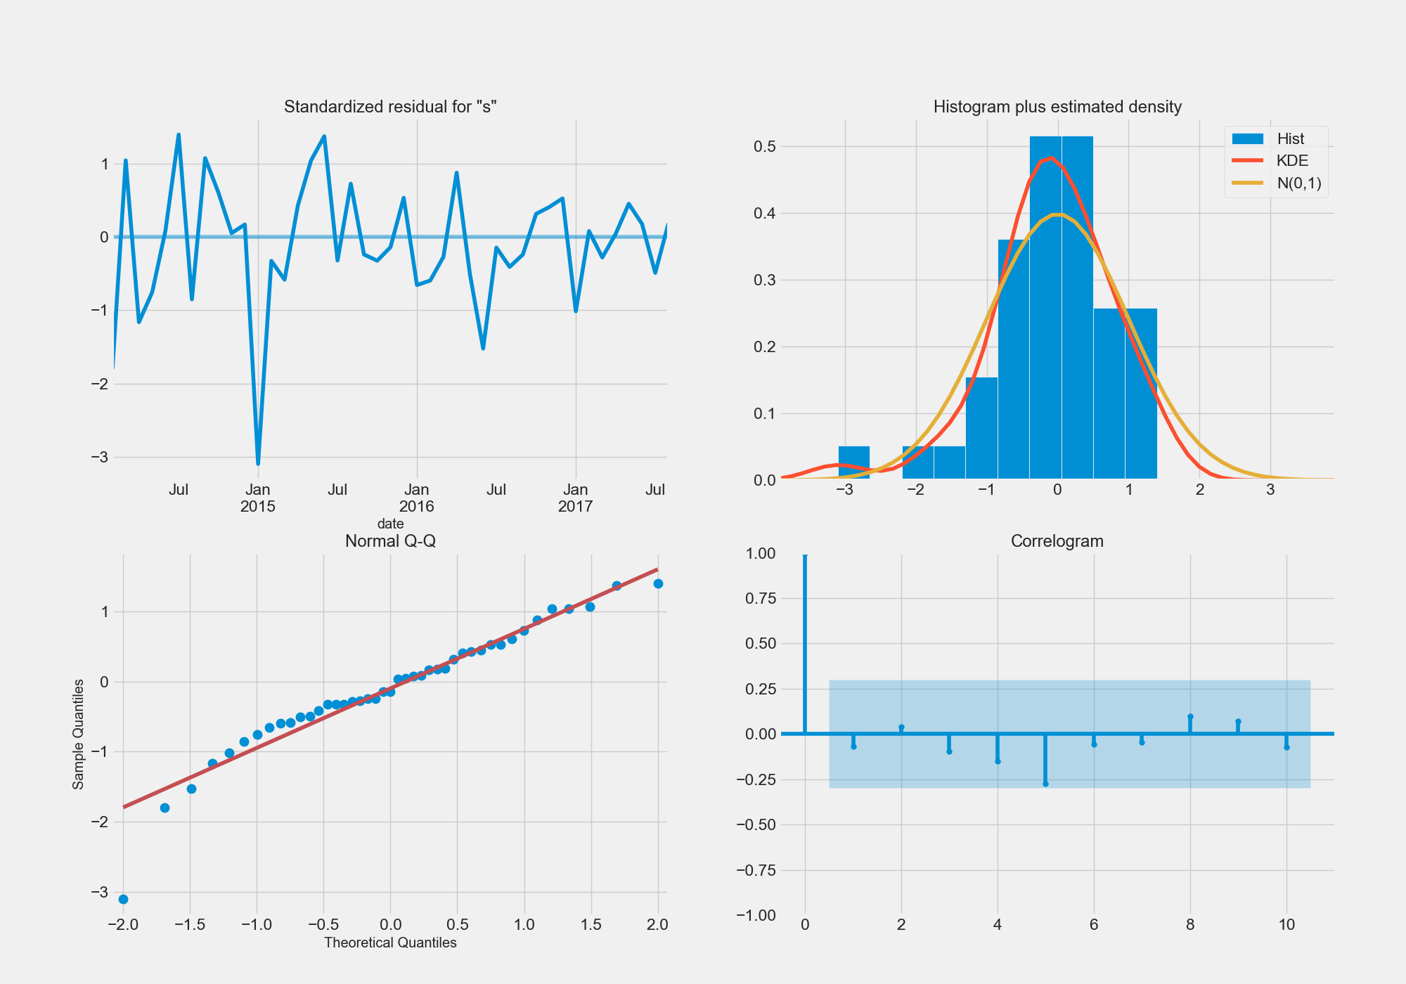
Notes:
Observations from diagnostics:
The residual errors fluctuate around a mean of zero and have a uniform variance.
The density plot suggest near normal distribution..
Most of the points fall in line with the red line. Distribution is not skewed. Normal data distribution is observed.
The Correlogram shows no autocorrelation on the residual errors.
Model is a good fit to proceed to forecasting.

Slide 10
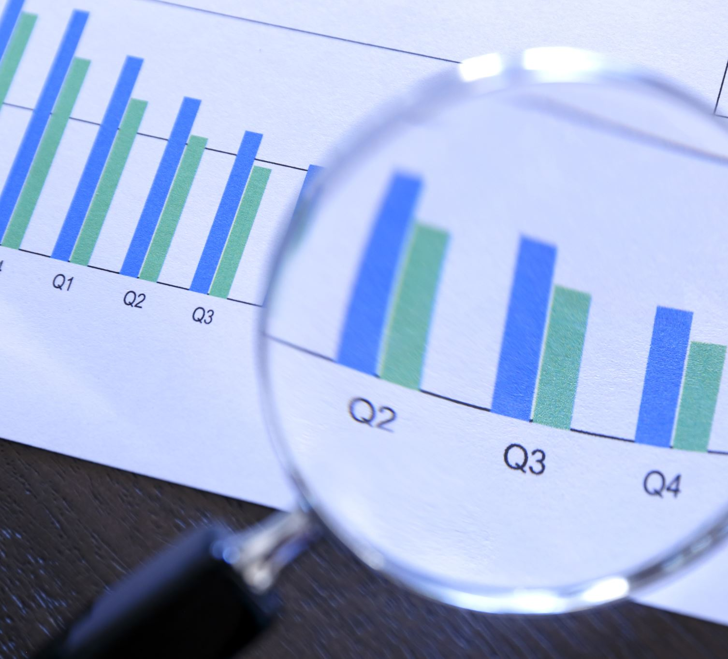
Validate Forecast

Slide 11
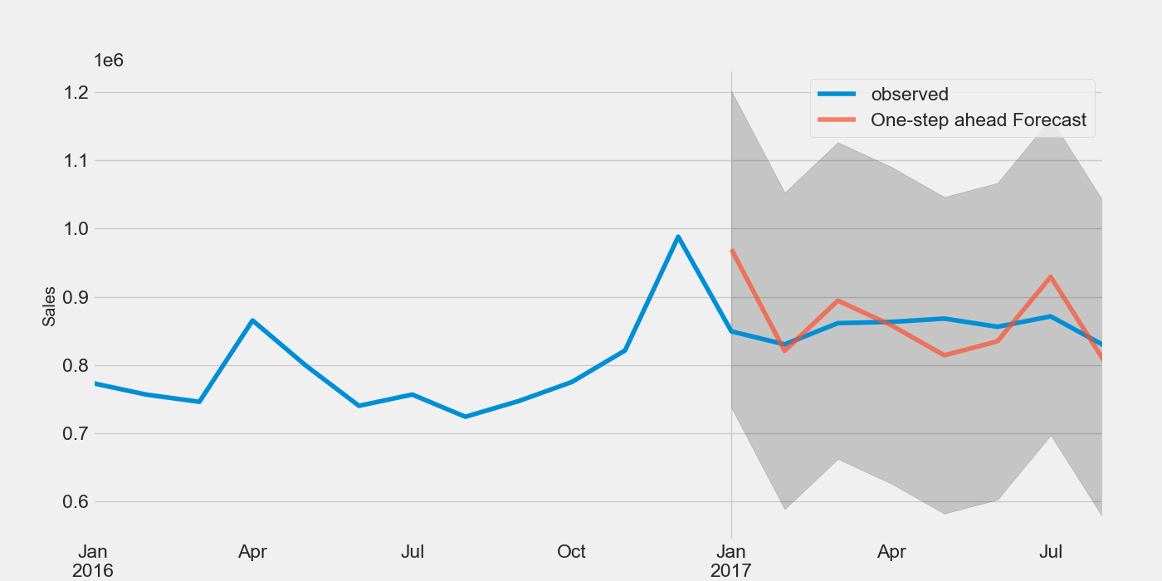
Validating With Actual Sales Data
Notes:
To understand the accuracy of the forecast, the predicted sales are compared to actual sales data. From the graph above, forecast date is to start on 01-01-2017 to the end of the data. We can see that forecast prediction looks acceptable as it follows the actual data closely.

Slide 12
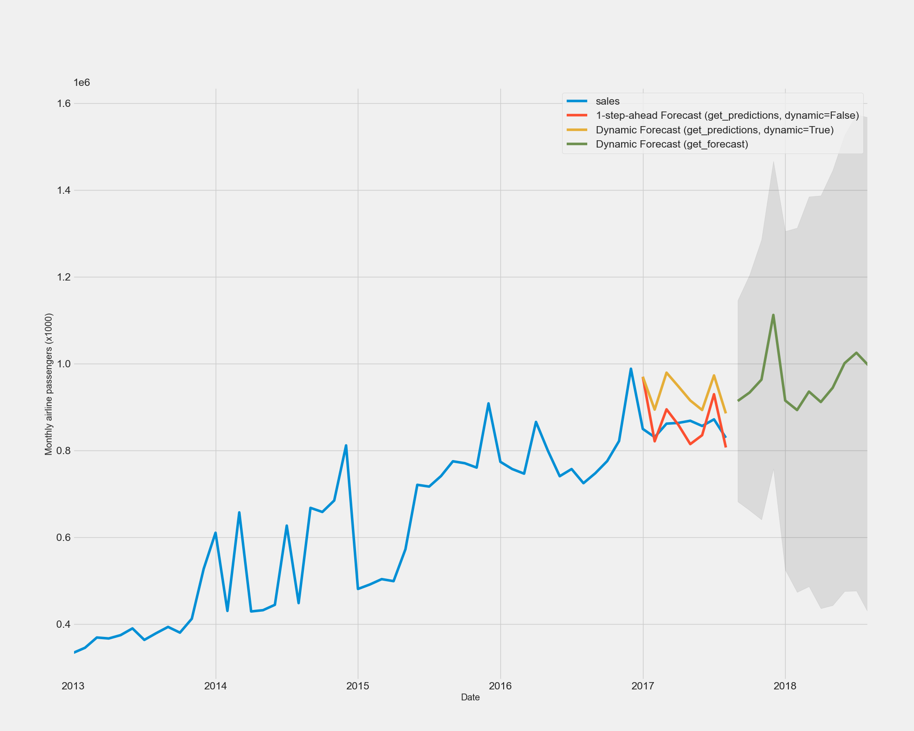
Forecasting
Forecasting looks acceptable as it follows seasonality of an upward trend in sales shortly before year end which similar to the previous years.
Notes:
For time-series forecasting, I’m using 3 different forecasting approach which are 1 step ahead forecast, dynamic forecast and truth forecast. Forecast looks acceptable as it follows seasonality of an upward trend in sales shortly before year end similar to previous years.
In [19]:

Slide 13
Sales Prediction Using Supervised Learning
Cleaning Data
Feature Engineering
Modeling
Prediction
Evaluate

Slide 14
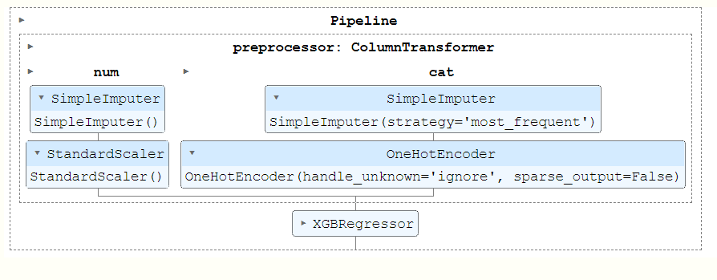
Notes:
The graphs above shows the preprocessing pipeline for my model:
First, I split the data into numerical and categorical data
For the numerical data, I fill the null values with mean and standard scale
For the categorical data, I fill the null values with mode and using onehot encoder to convert data into numerical data
After preprocessing the data, I fit the dataset to XGBOOST algorithm

Slide 15
Validating and Comparing
 | Mean Square Error | Mean Absolute Percentage Error | Root Mean Squared Error
Time Series | 2854912236.01 | 0.05 | 53431.38
XGBOOST | 60875.58 | 354828436823303.3 | 246.73

Slide 16
Reference
https://www.kaggle.com/learn/intro-to-deep-learning
https://www.kaggle.com/code/dimitreoliveira/deep-learning-for-time-series-forecasting
https://www.kaggle.com/code/datafan07/time-series-analysis-forecast-with-visualization
https://machinelearningmastery.com/time-series-data-stationary-python/
https://www.scribbr.com/statistics/pearson-correlation-coefficient/

Slide 17

Thank you for listening

